Slide 1
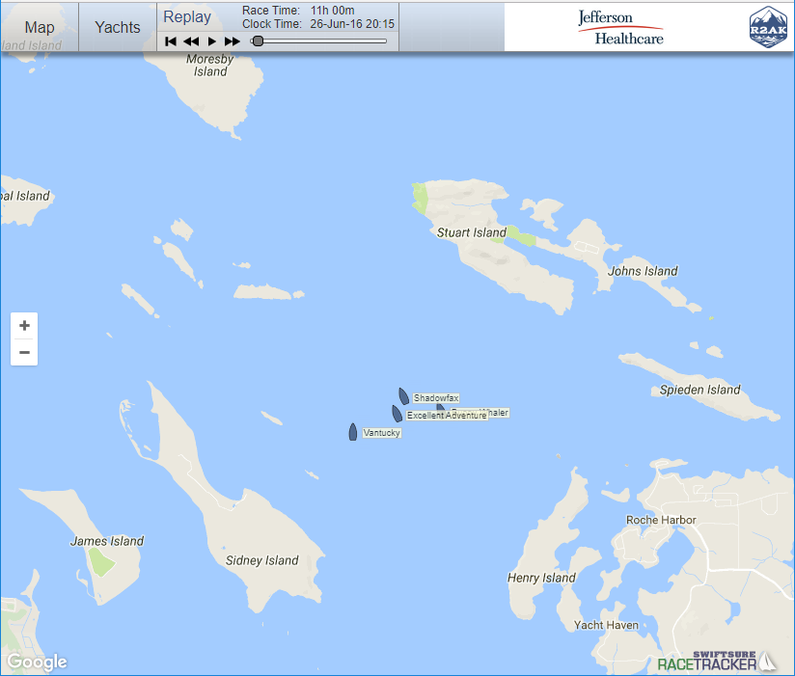

Current State
R2AK logo blue
(59, 84, 129)
3b5481
R2AK secondary
(238,85,18)
ee5512
Land
#EBE8DE
R2AK secondary
(98, 99, 102)
626366
Water
#A3CCFF

Slide 2
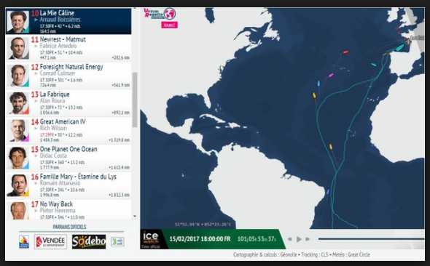
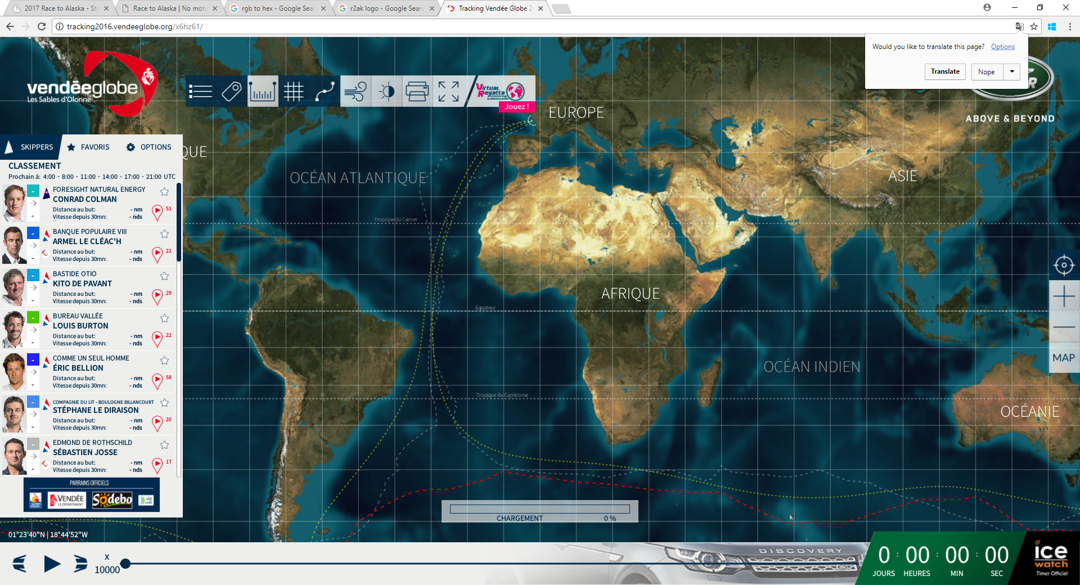
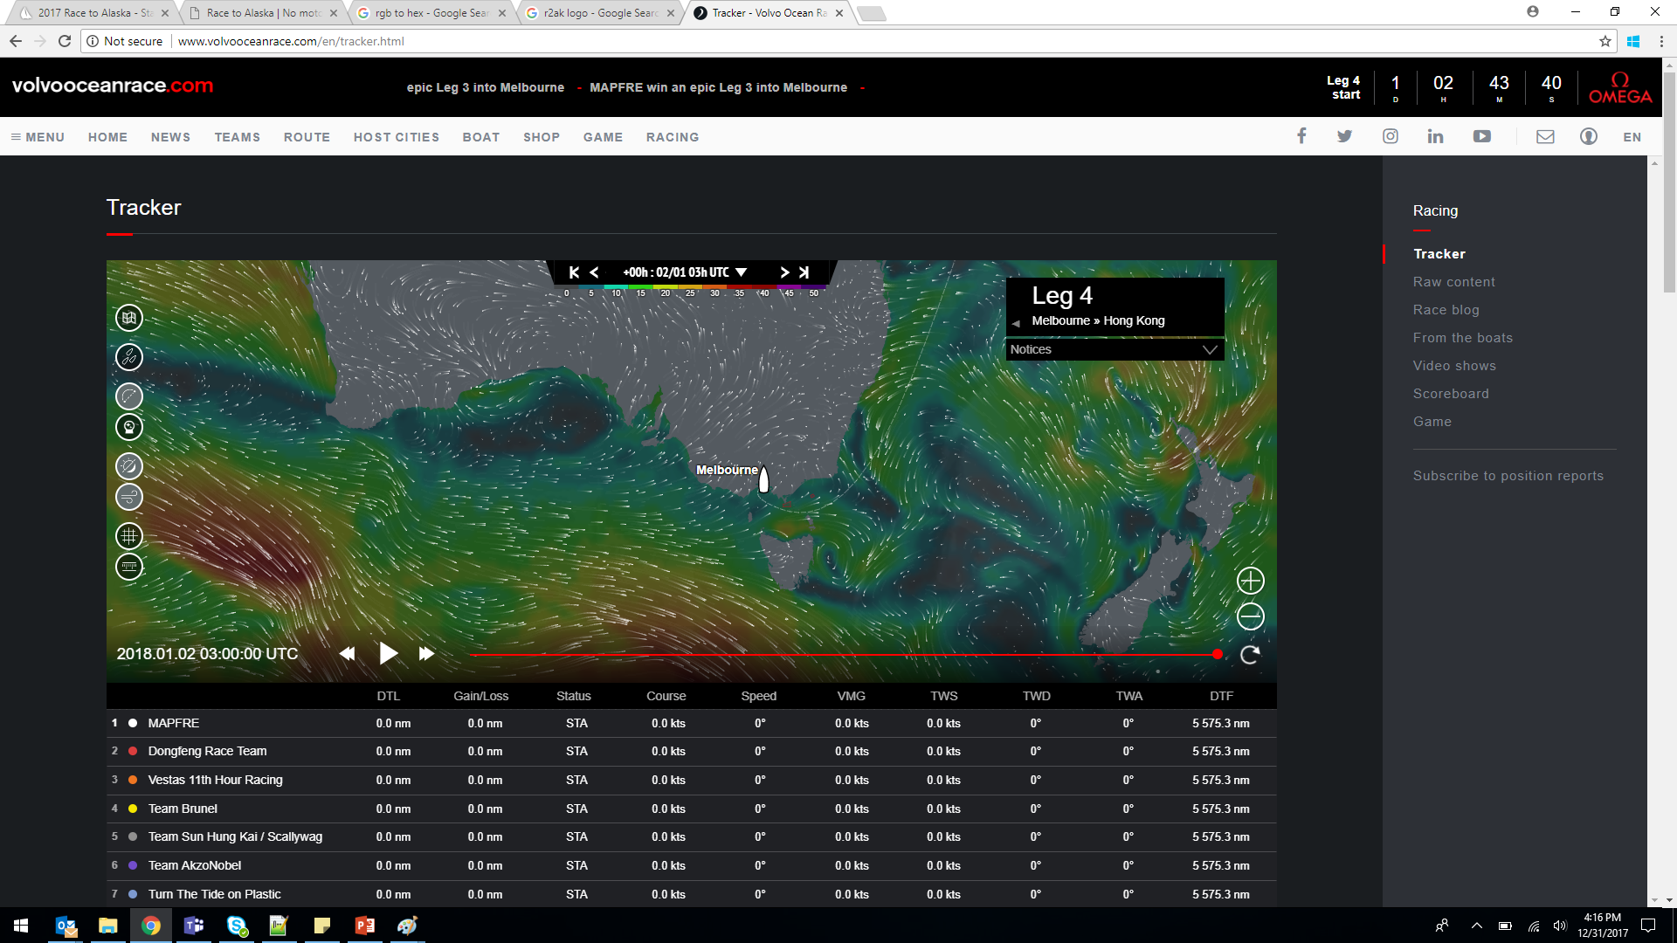
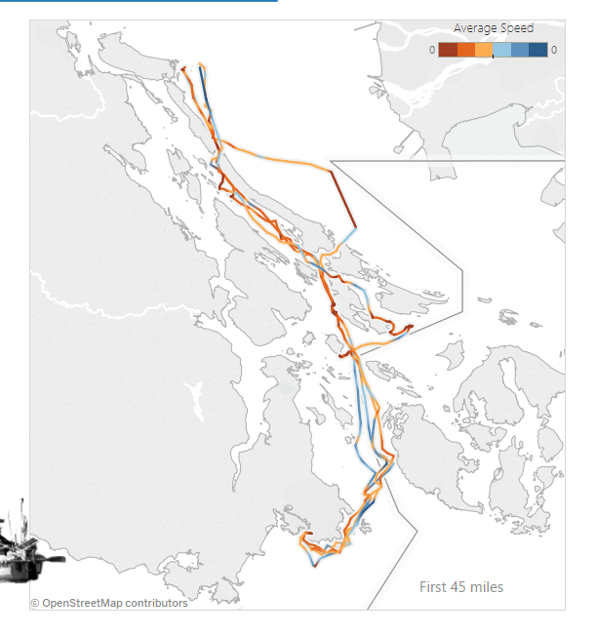
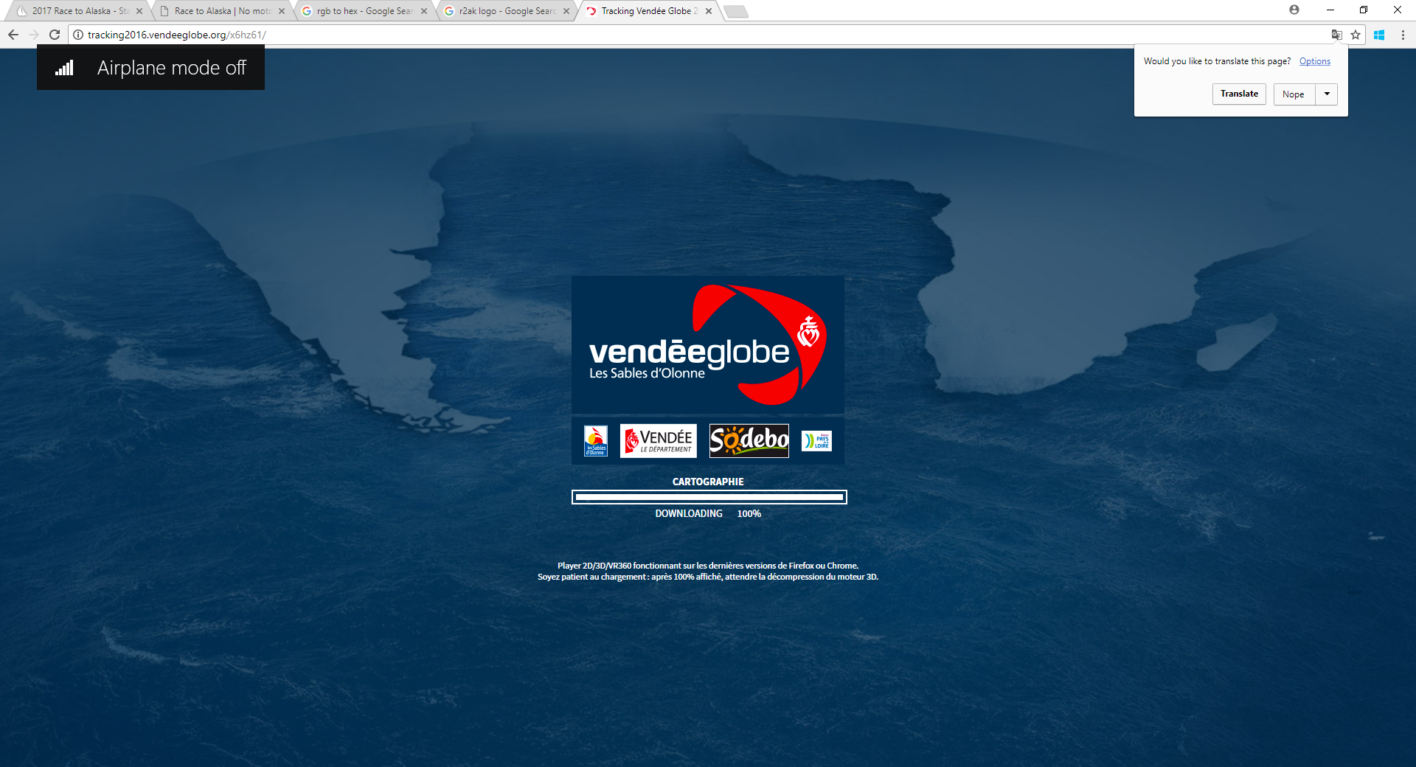
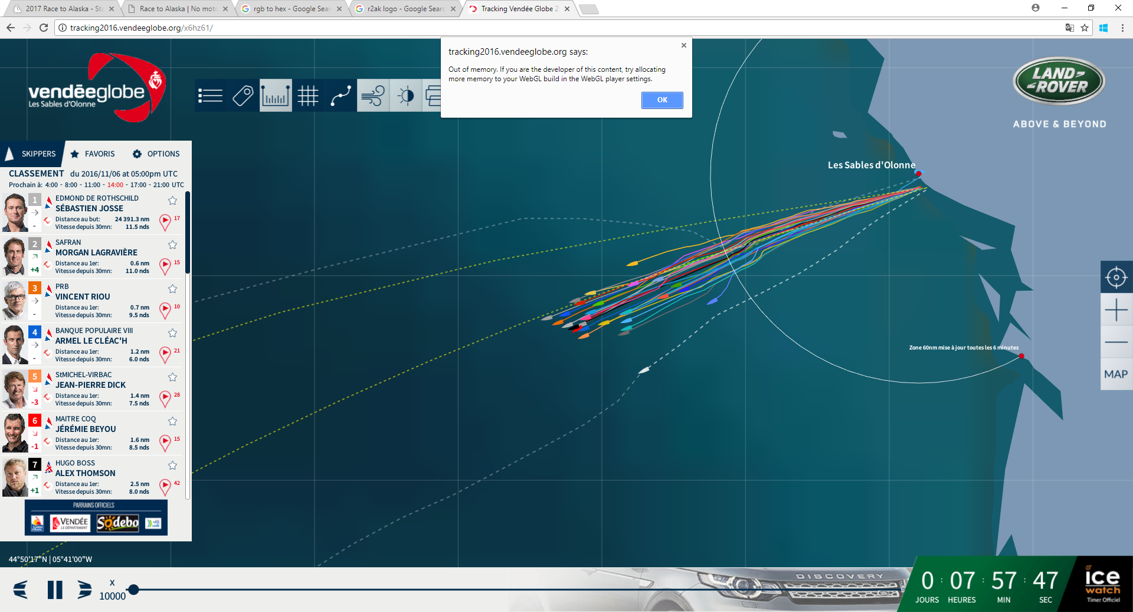
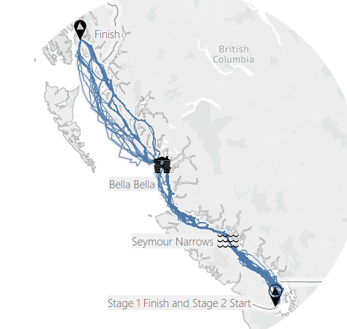
Prior Art
Volvo Ocean Race
Vendee Globe

Slide 3
Prior Art: Colors
Volvo Ocean Race
Vendee Globe
Water
Land
#575D63
Land
#ECECEC
Water
#FFFFFF
Water
#203854
(32,56,84)
Land
#E7E9E8
231,233,232
Water
#0B2F3F
Water
#115D6E
Land
#7C98B4

Slide 4
More Colors
Water
Land
#575D63
8e9fbd
(142,159,189)
R2AK secondary
(238,85,18)
ee5512
Water
#FFFFFF
Land
#ECECEC
5e749c
(94,116,156)
R2AK logo blue
(59, 84, 129)
3b5481
R2AK secondary
(98, 99, 102)
626366
Water
#203854
Land
#E7E9E8
223b69
(34,59,105)
Water
#0B2F3F
Water
#115D6E
Land
#7C98B4
0d234b
(13,35,75)
Water
#A3CCFF
Land
#EBE8DE

Slide 5
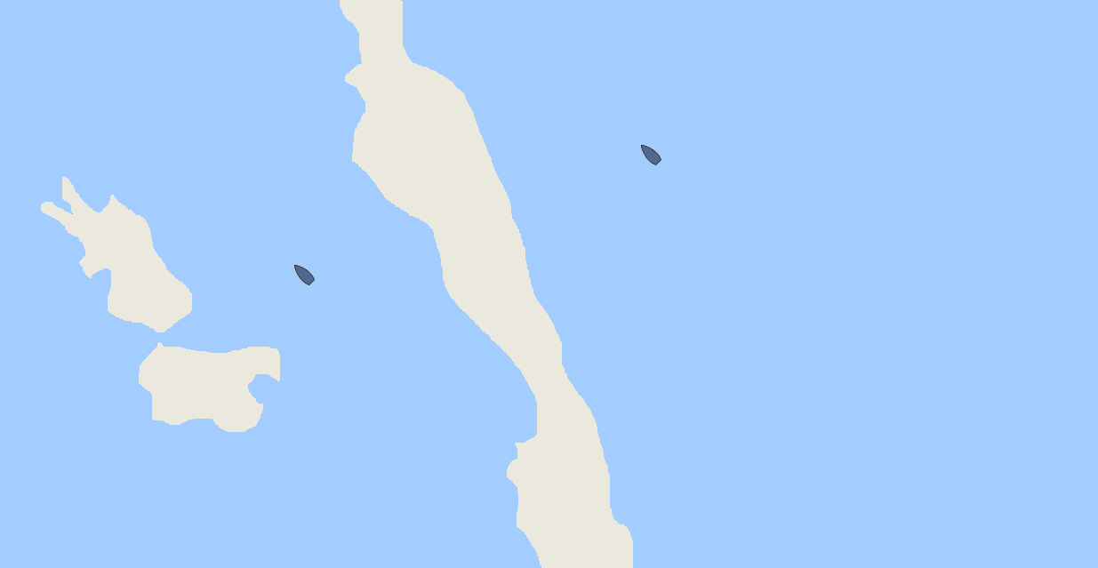
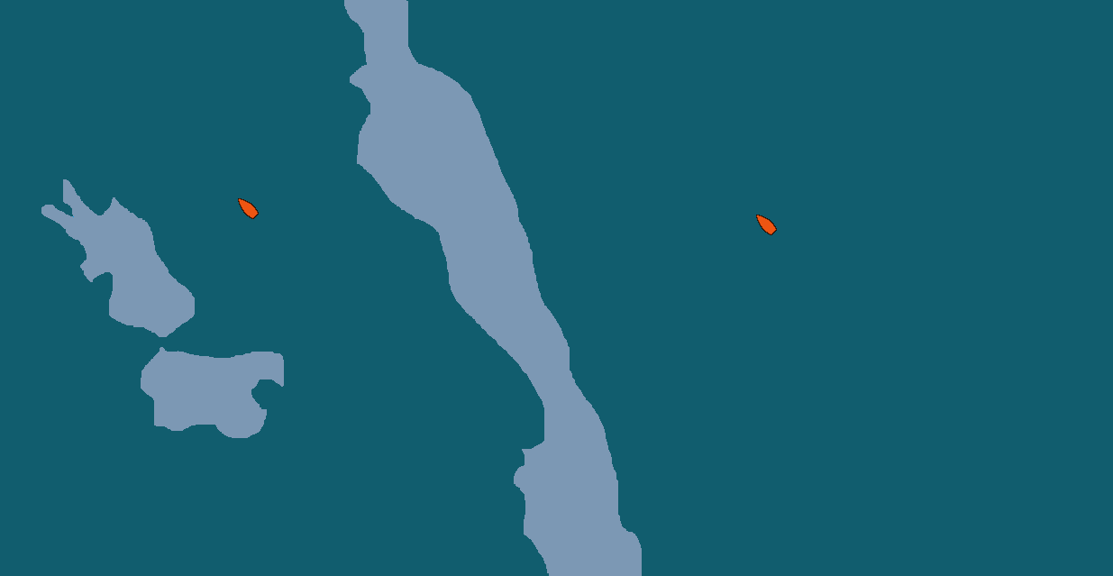
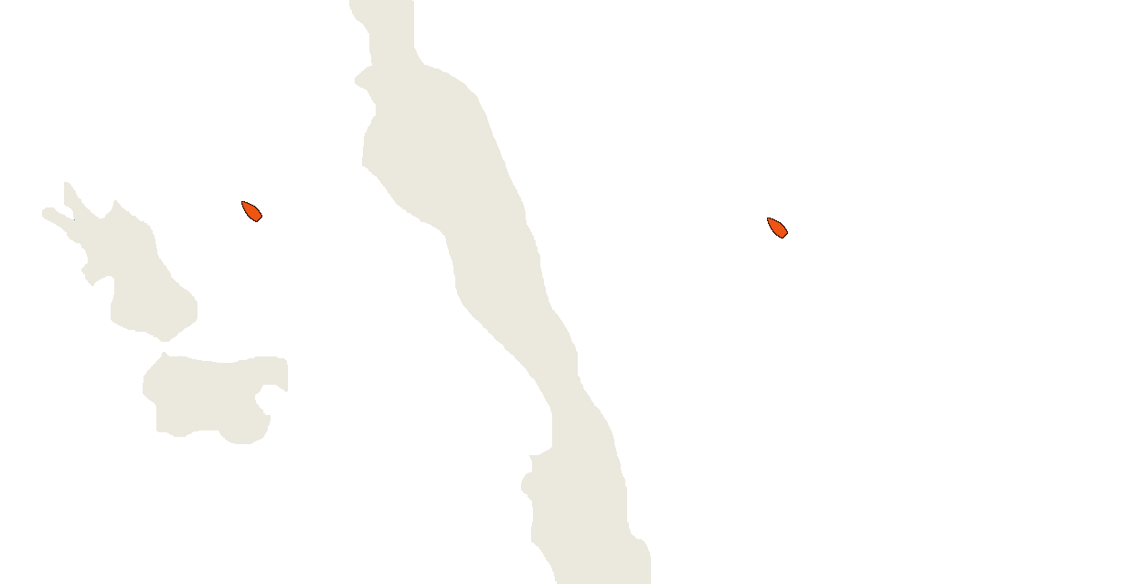
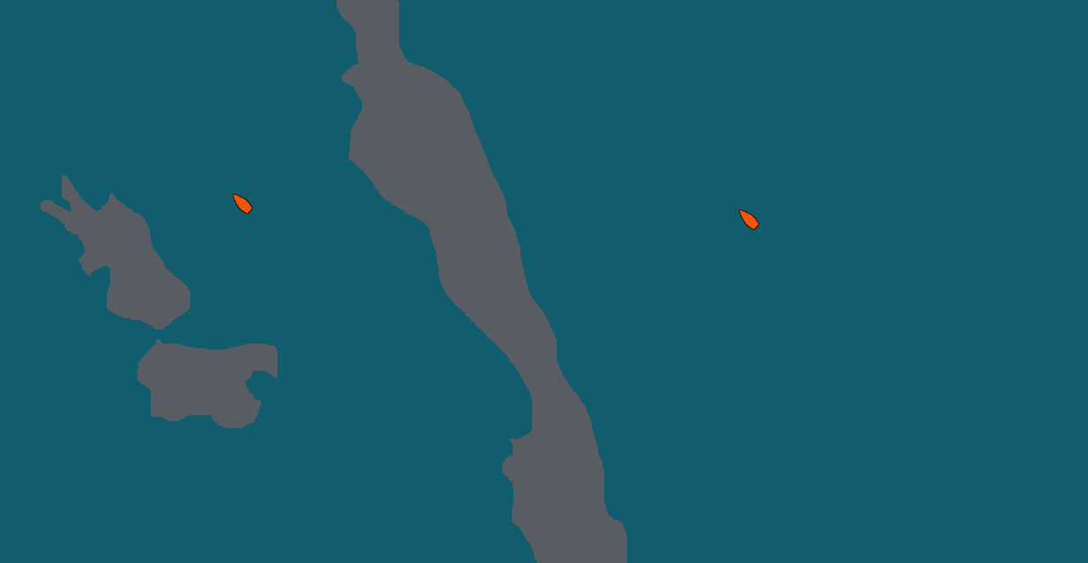
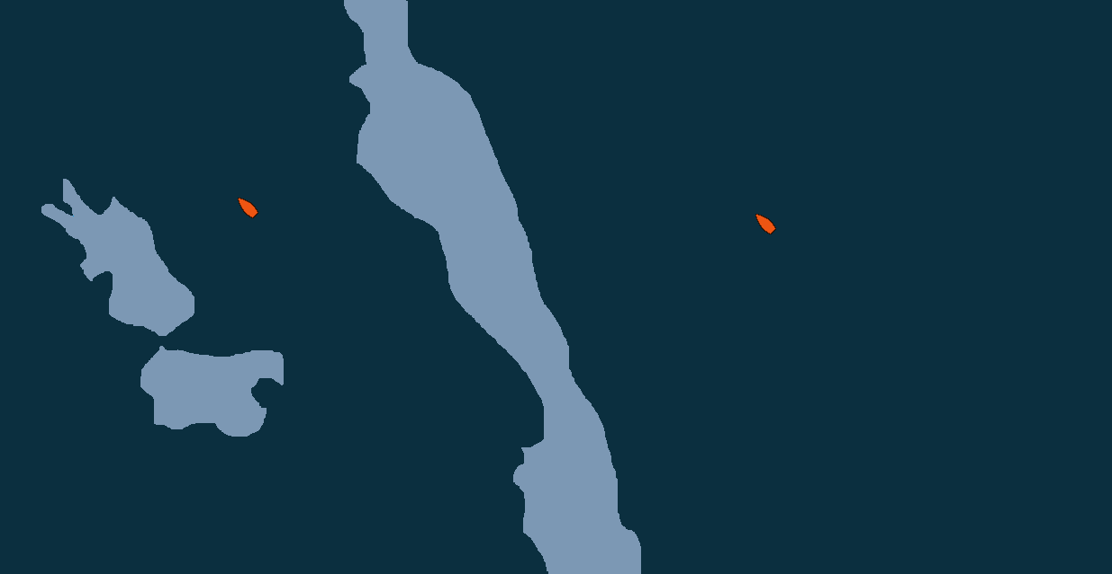
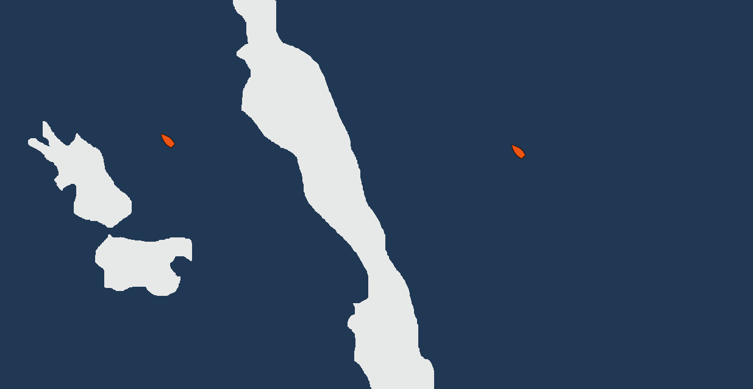
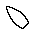

Copycat Palette
Classic R2AK / Default Google Maps
Vendee Globe
Tableau Viz
Volvo Ocean Race
Vendee Globe
Vendee Globe

Slide 6
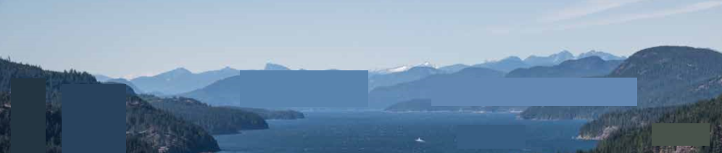
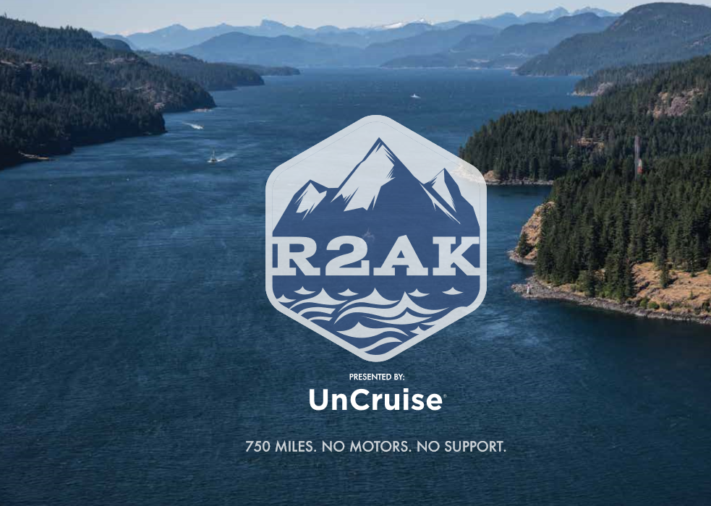
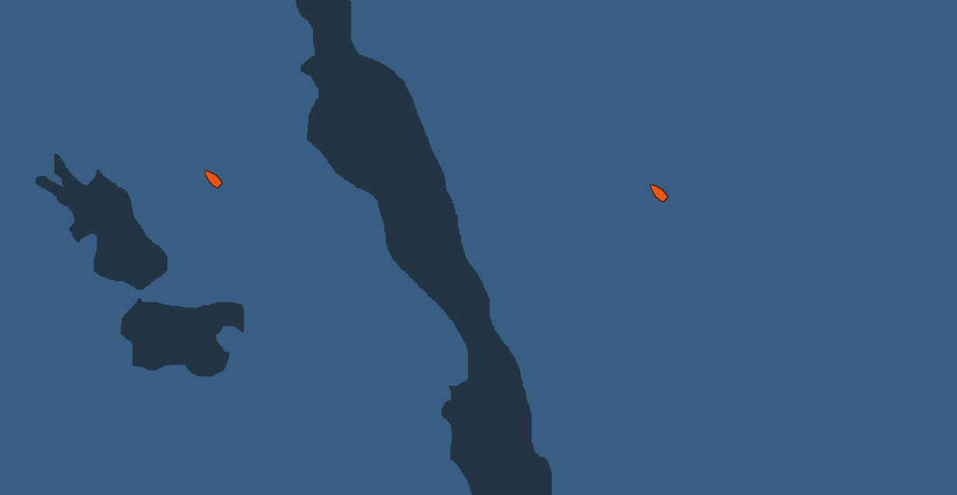

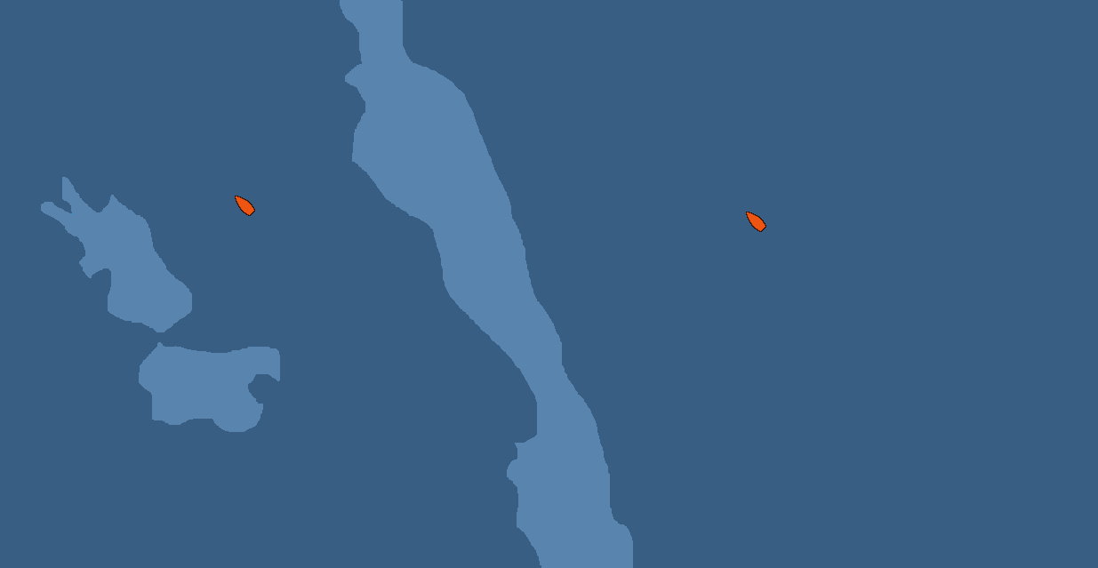
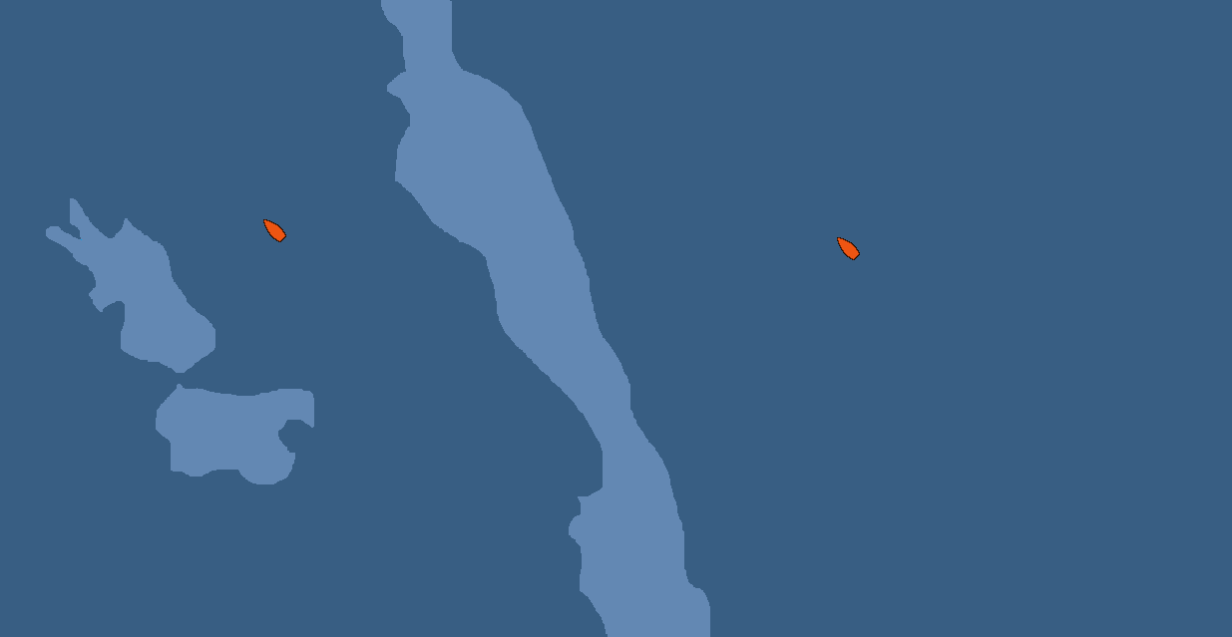
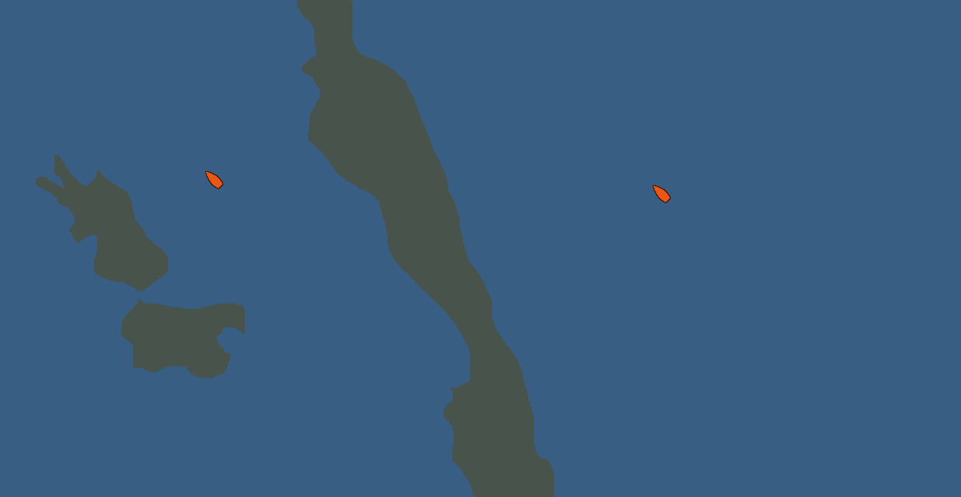
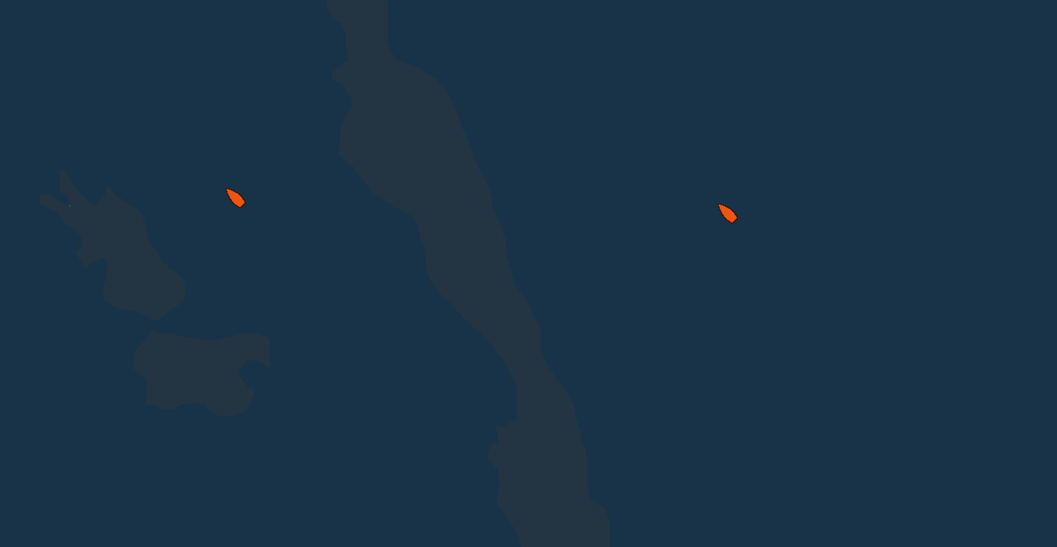
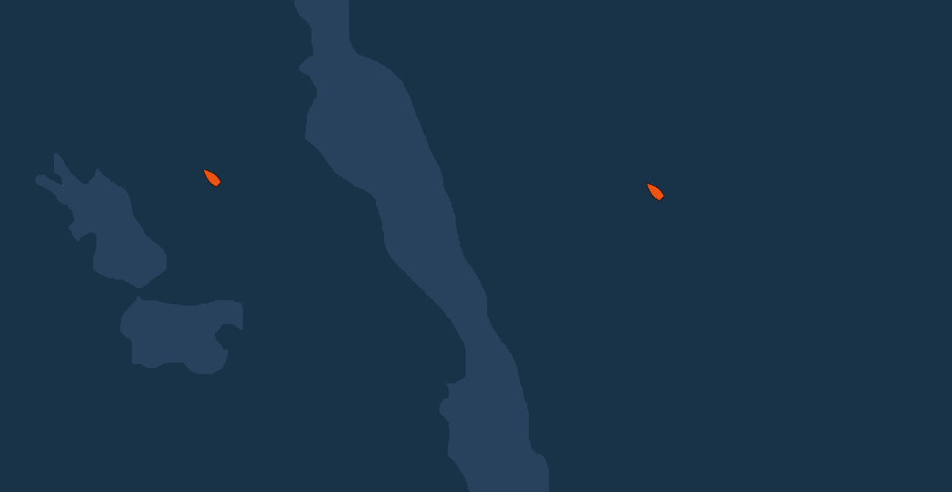
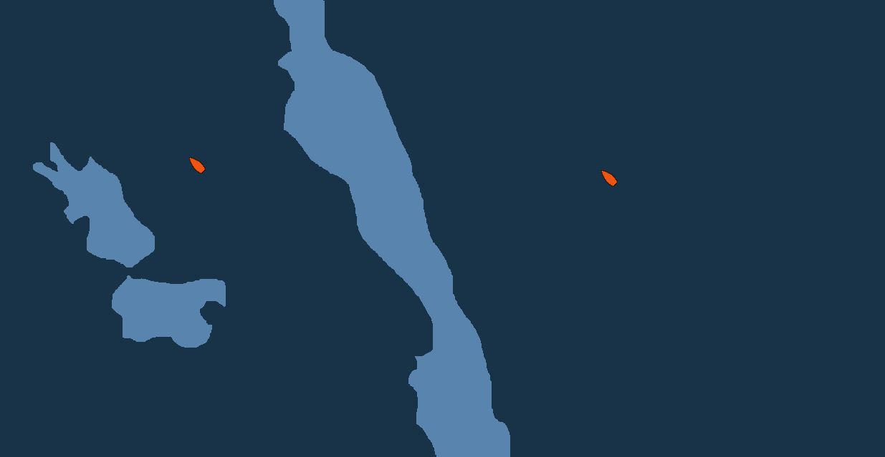

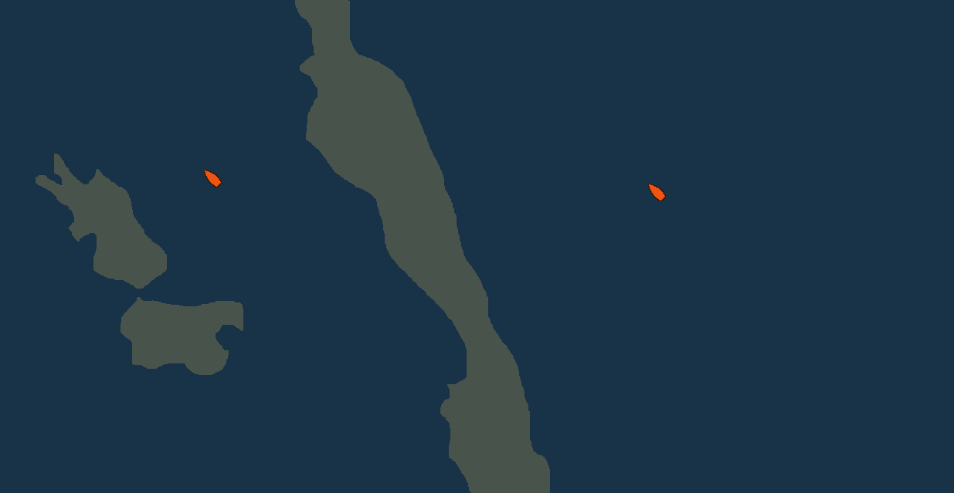
Realistic Palette
#233542
(35,53,66)
#28425D
(40,66,93)
#5984AE
(89,132,174)
#6388B3
(99,136,179)
#48534B
(72,83,75)
#183348
(24,51,72)
#385E83
(56,94,131)
#233542
(35,53,66)
#28425D
(40,66,93)
#5984AE
(89,132,174)
#6388B3
(99,136,179)
#48534B
(72,83,75)
#385E83
(56,94,131)
#183348
(24,51,72)

Slide 7
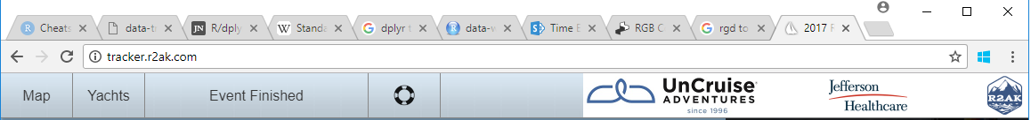

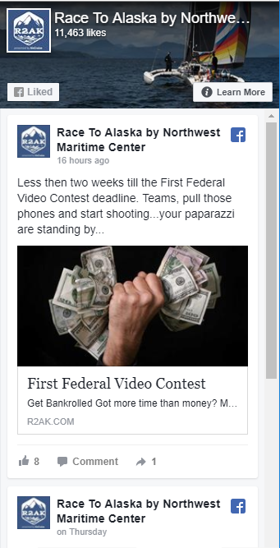
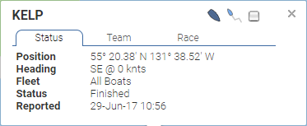
#183348
(24,51,72)
#2F475A
(47, 71, 90)
#465B6C
(70, 91, 108)
#5D707E
(93, 112, 126)
#748491
(116, 132, 145)
#8B99A3
(139, 153, 163)
#A2ADB5
(162, 173, 181)
#B9C1C8
(185, 193, 200)
#D0D6DA
(208, 214, 218)
#E7EAEC
(231, 234, 236)
#FFFFFF
(255, 255, 255)

